Slide 1

DMDW Lab using PYTHON
5th Semester
Department of Computer Science and Engineering
GIET University, Gunupur

Slide 2
Assignment-7
Introduction to sklearn (scikit-learn) library.
Classification using decision tree induction.

Slide 3
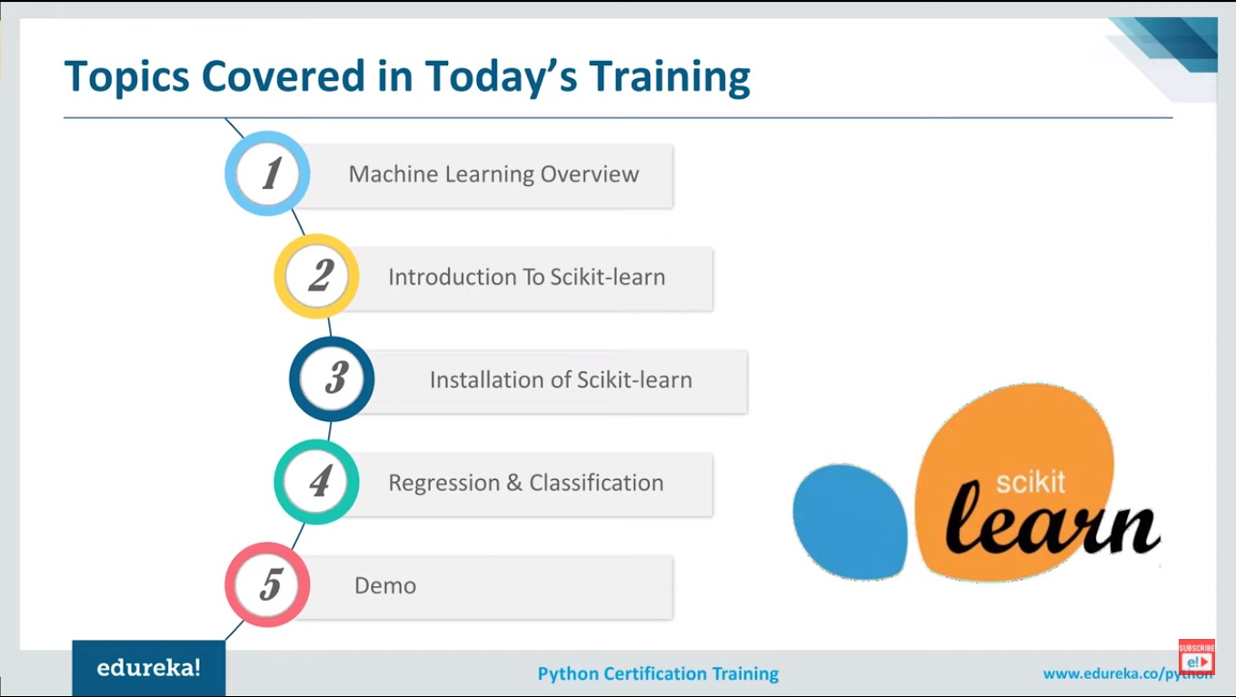

Slide 4

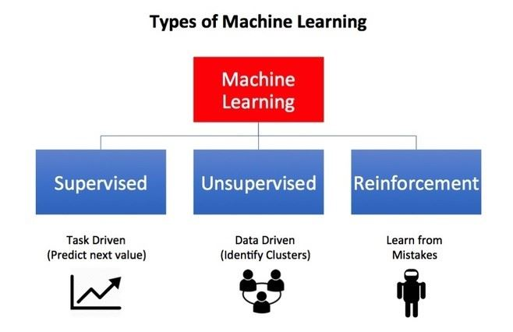
Machine Learning :
Machine learning is the science of getting computers to act without being explicitly programmed. In the past decade, machine learning has given us self-driving cars, practical speech recognition, effective web search, and a vastly improved understanding of the human genome.

Slide 5
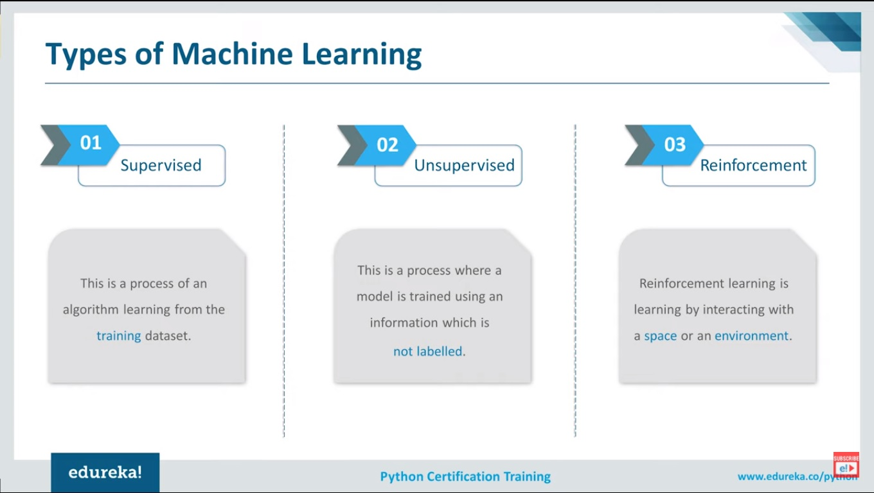

Slide 6
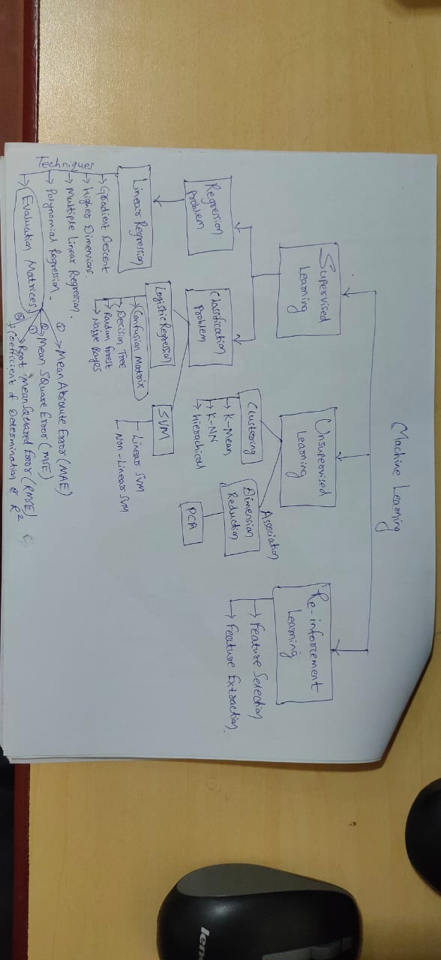

Slide 7
Supervised learning is when the model is getting trained on a labeled Dataset. Labeled dataset is one which has both input and output parameters.
There are two types of Supervised Learning techniques:
Regression:
Classification:
Supervised Learning

Slide 8
Regression:
The regression algorithm will keep moving the line through each iteration, trying to find the best-fitting line, in other words, the line with the minimum error.
There are several techniques to perform this task and the ultimate goal is to get the line closer to the maximum number of points. Like:
- Gradient Descent,
- Higher Dimensions,
Multiple Linear Regressions,
Polynomial Regression,
Regularization,
---→Evaluation Matrices
Supervised Learning

Slide 9
Classification:
Classification is the process of assigning a ‘class label’ to a particular item.
Now that we know what exactly classification is, we will be going through the classification algorithms in Machine Learning:
--Logistic Regression--→ Confusion Matirx
--Decision Tree
--Random Forest
--Naive Bayes
Supervised Learning

Slide 10
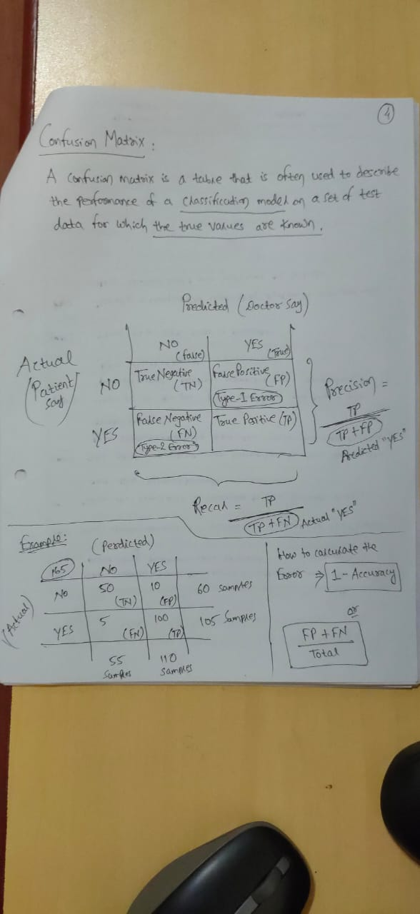
Confusion Matrix

Slide 11

SVM

Slide 12
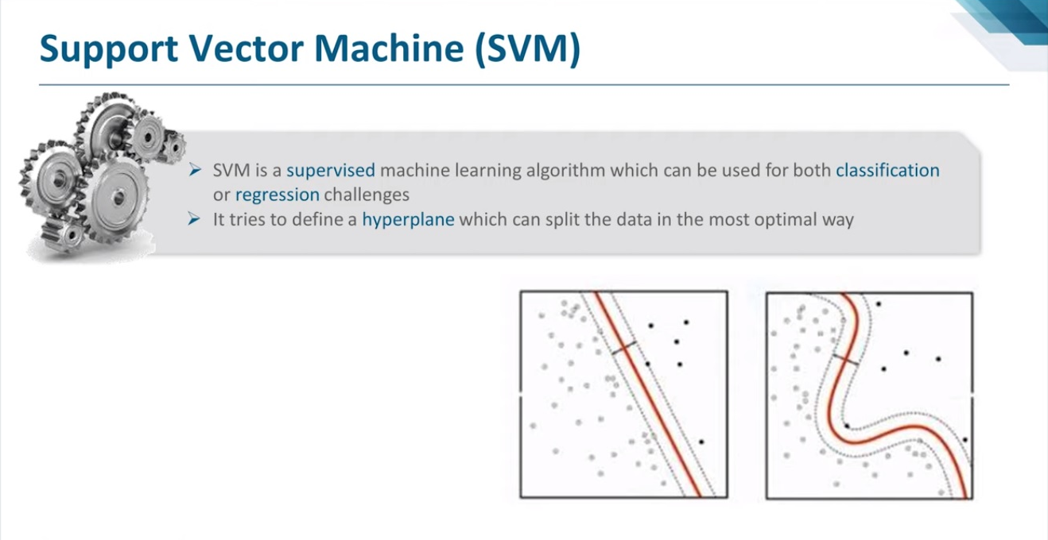

Slide 13
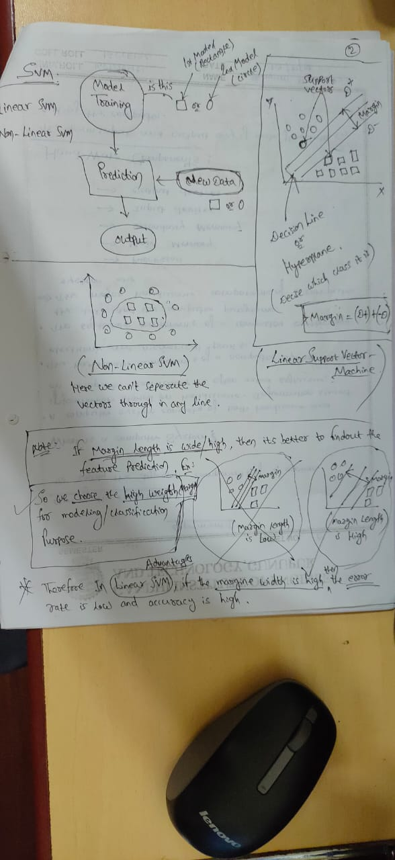
SVM

Slide 14
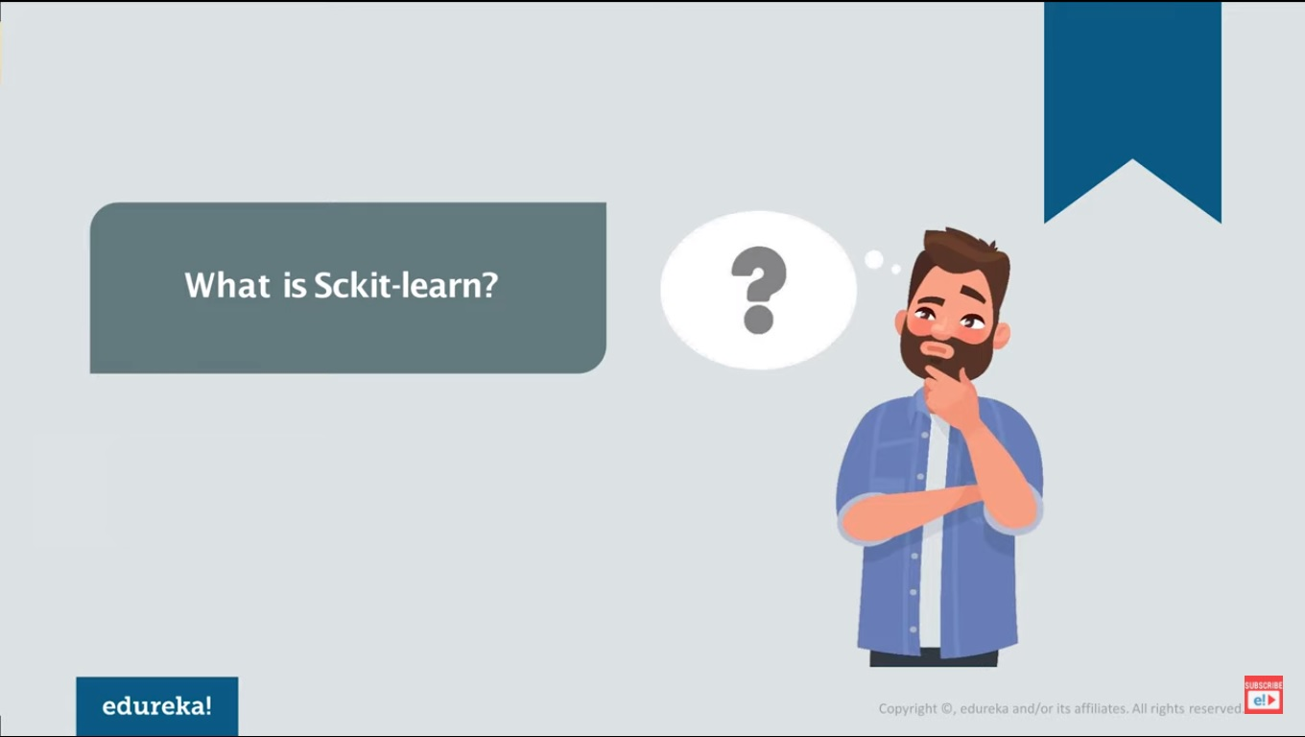

Slide 15
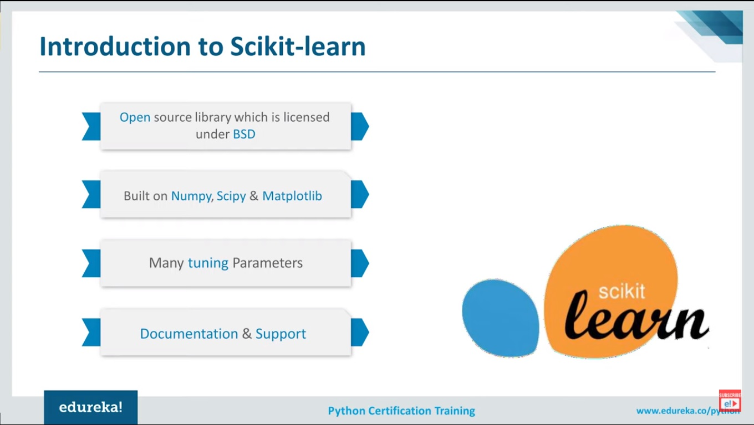
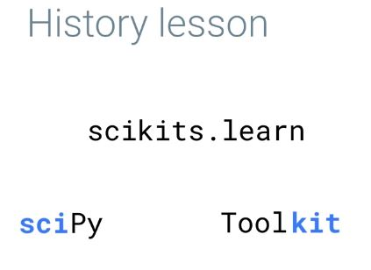

Slide 16
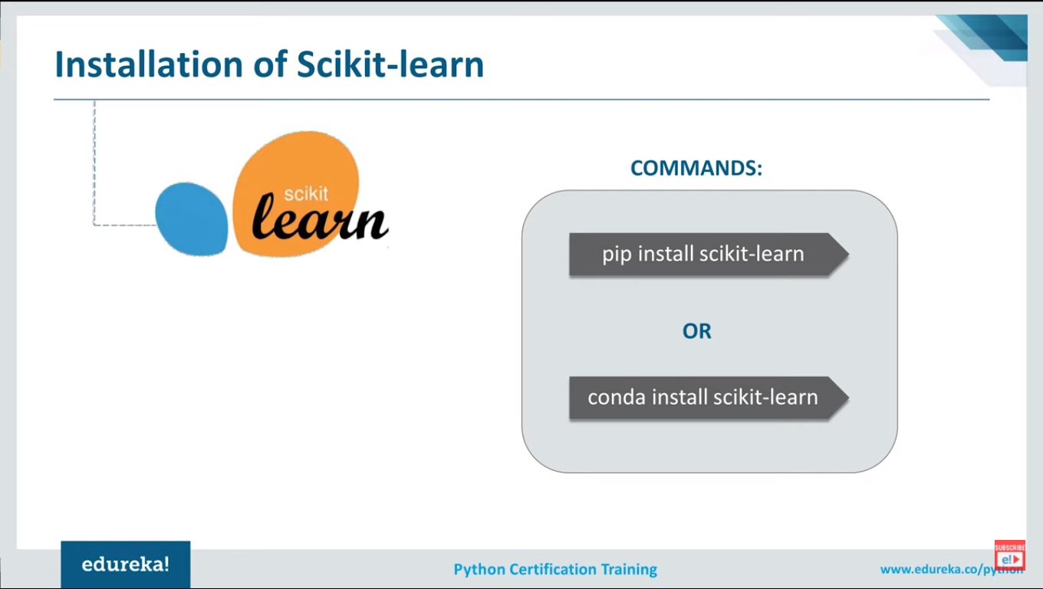

Slide 17
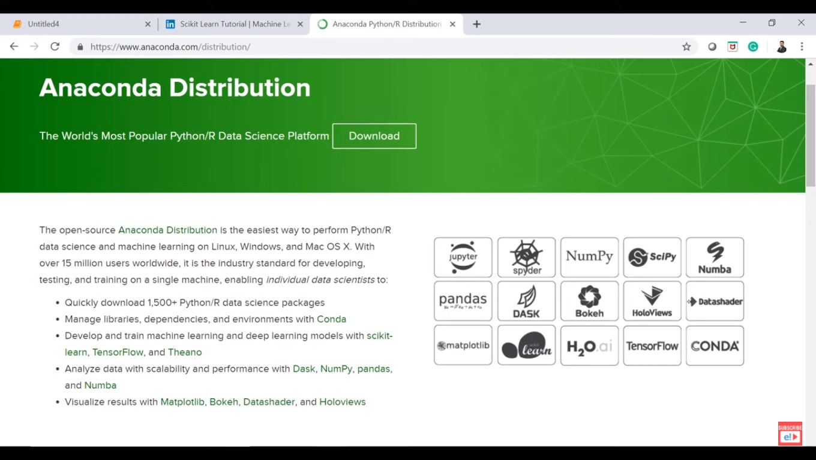

Slide 18
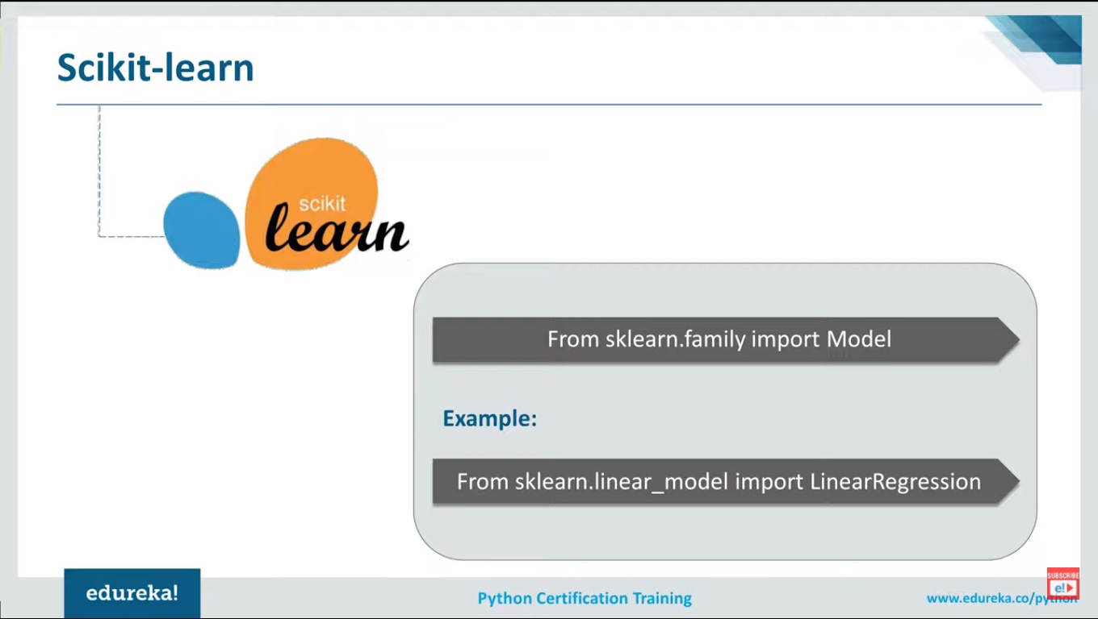

Slide 19
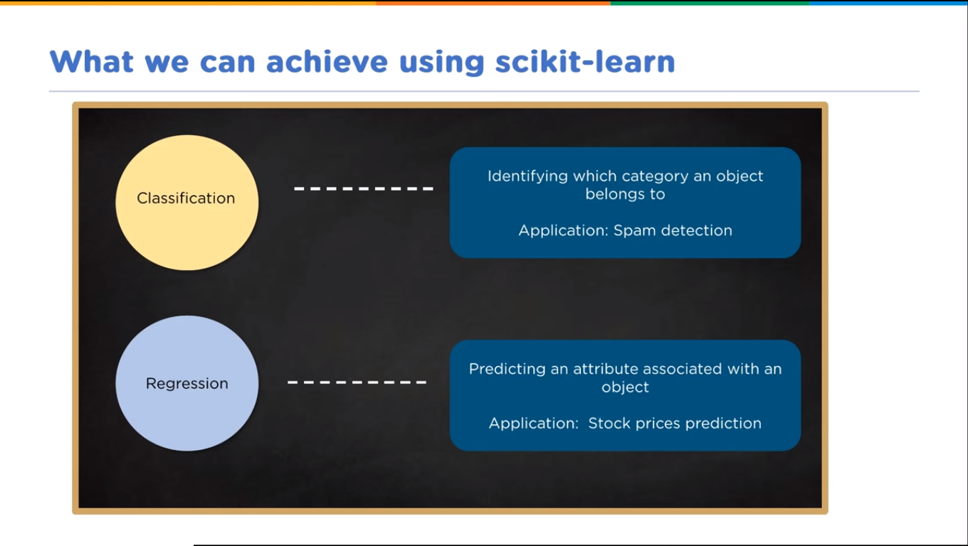

Slide 20
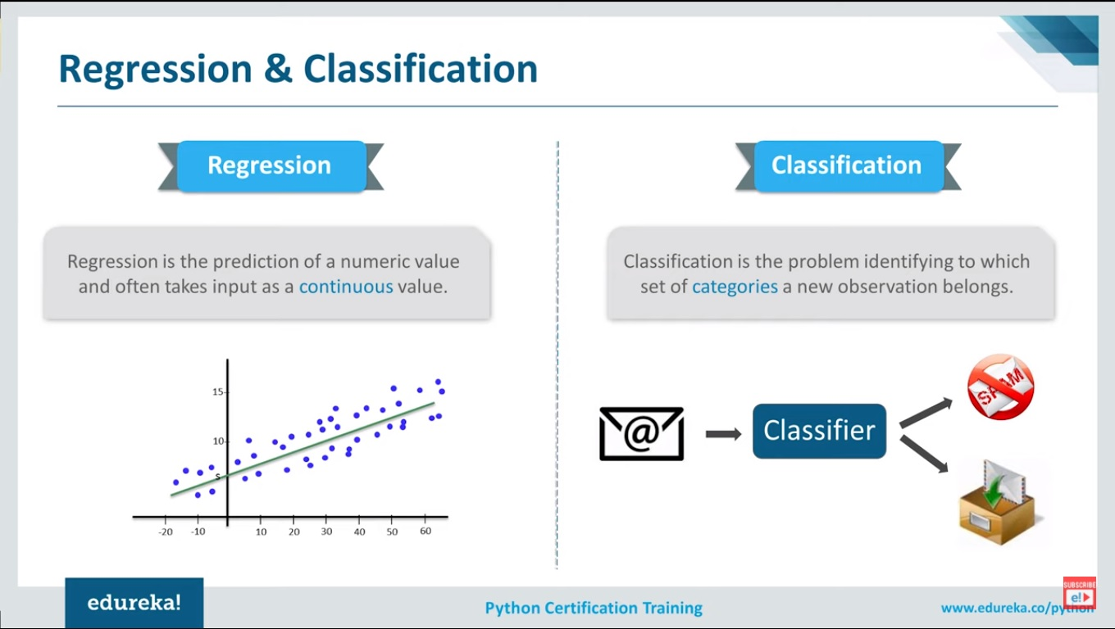

Slide 21
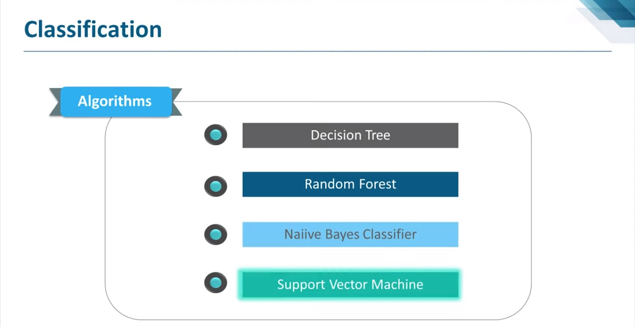

Slide 22
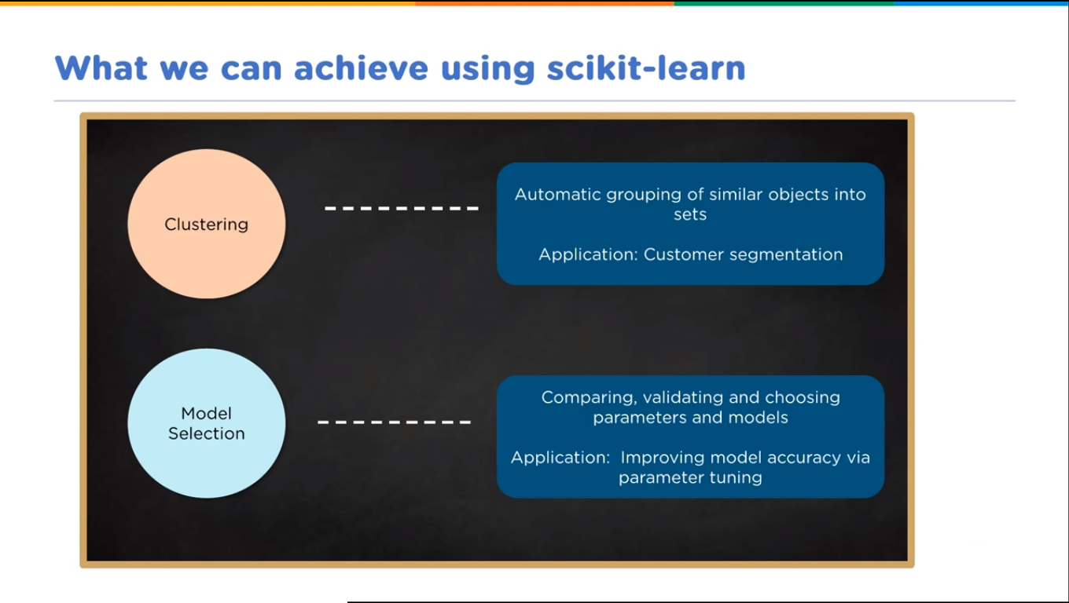

Slide 23
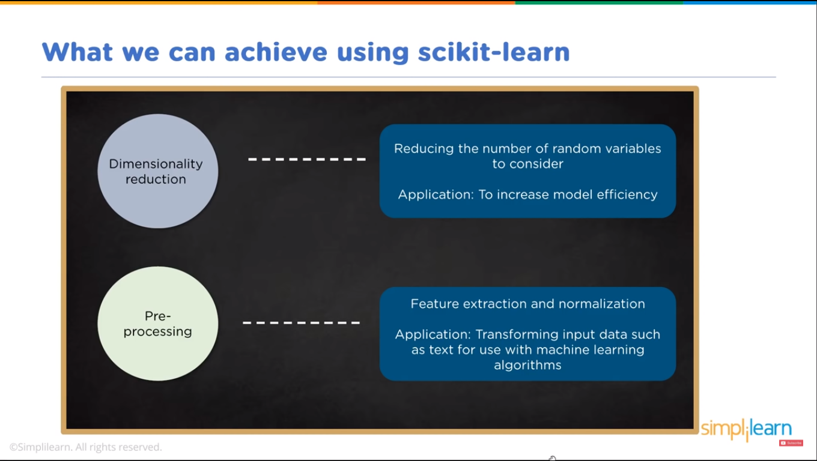

Slide 24
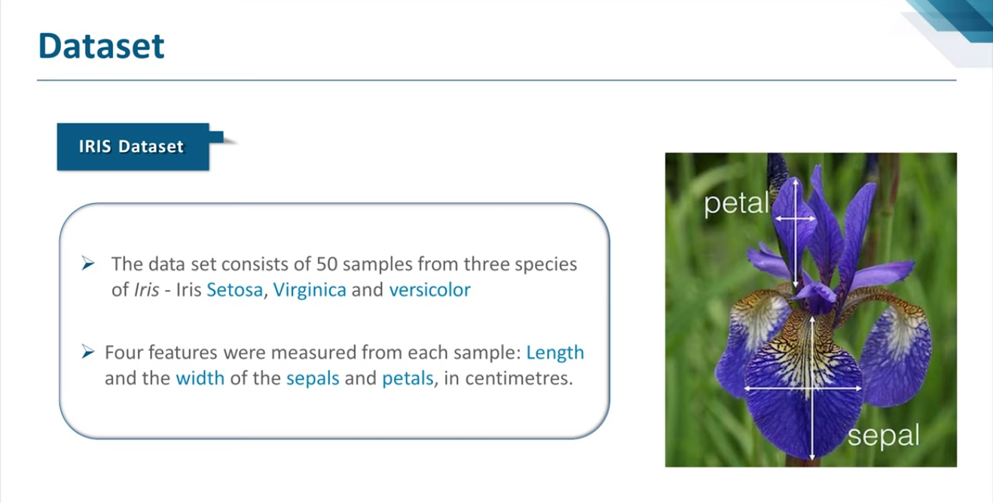

Slide 25
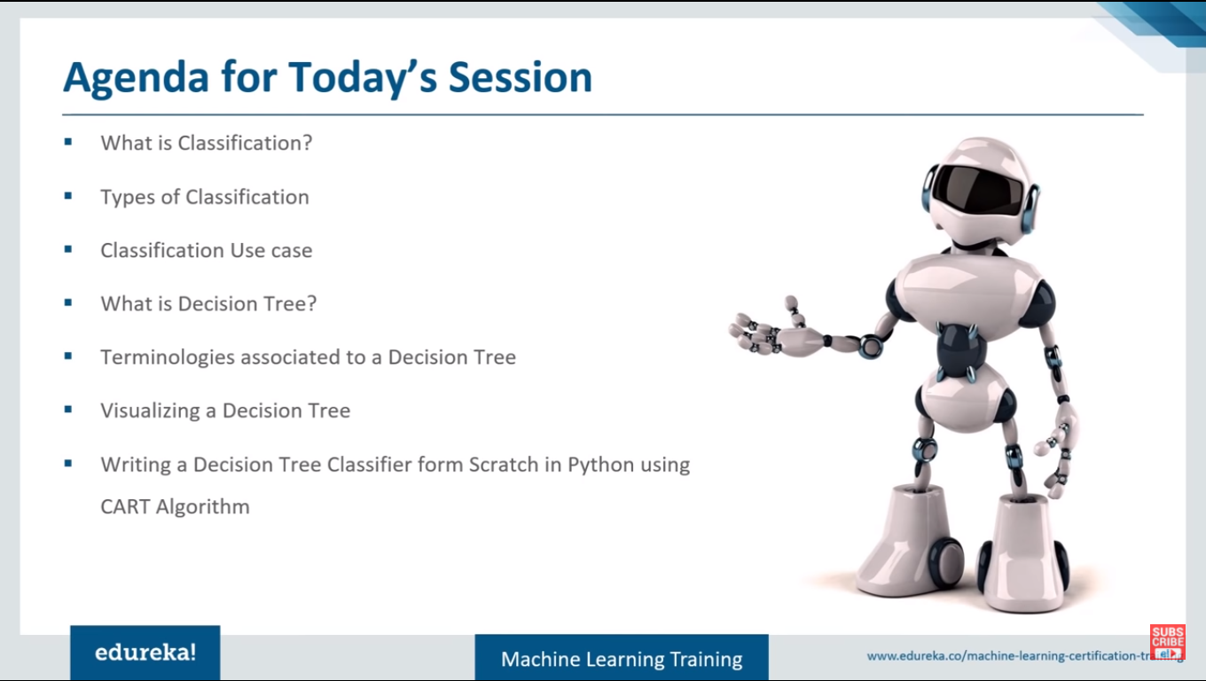
Now our next

Slide 26
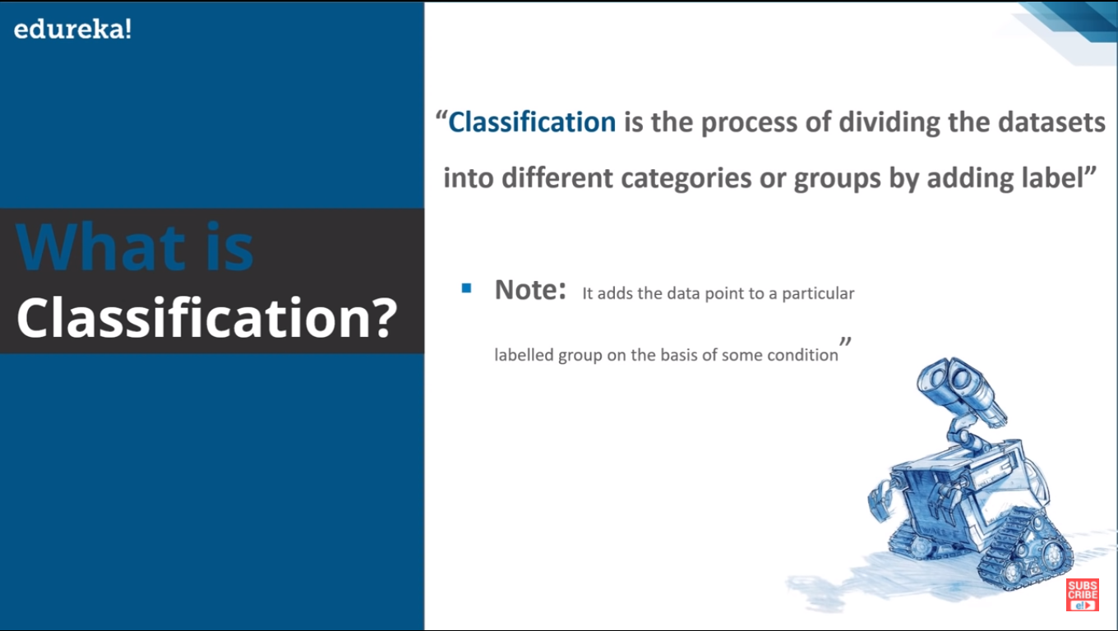

Slide 27
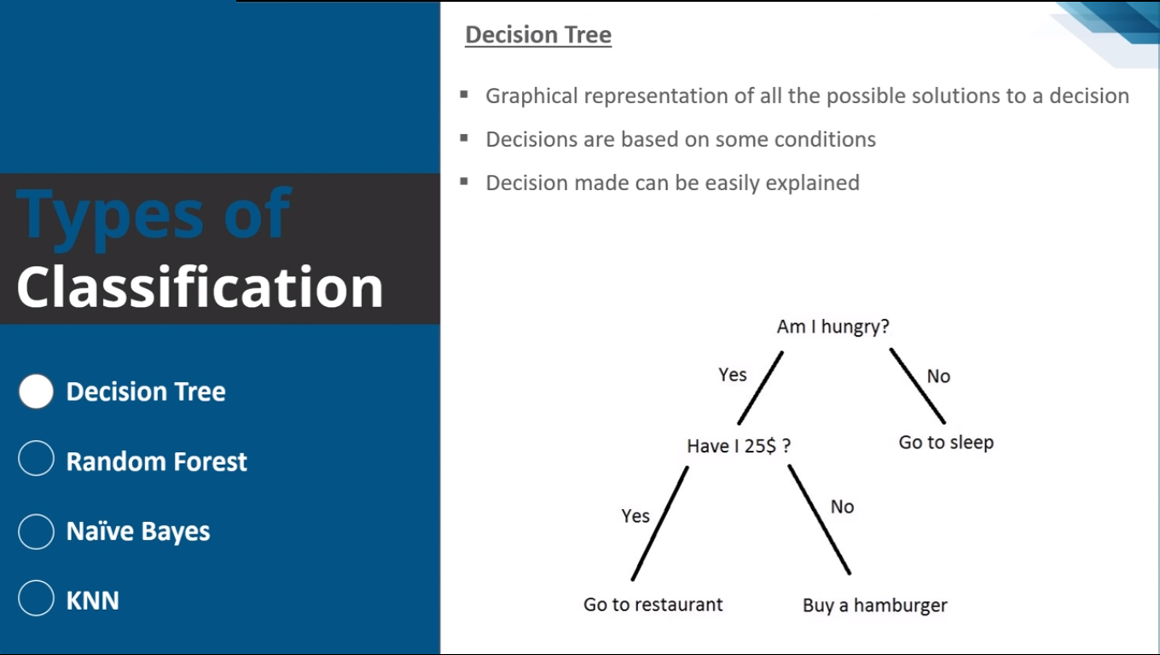

Slide 28
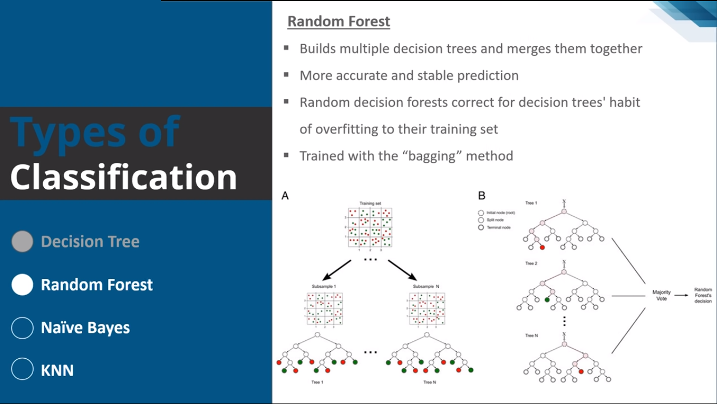

Slide 29
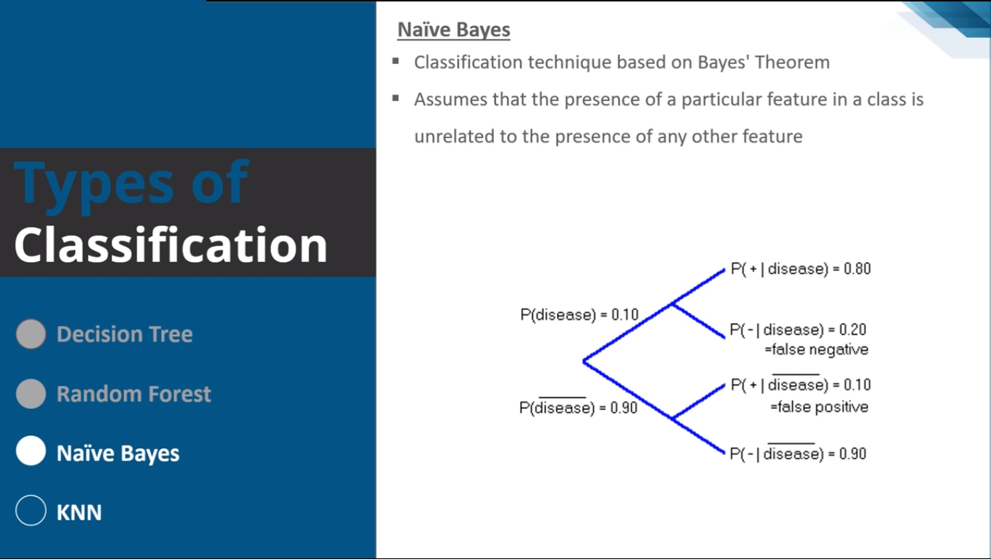

Slide 30
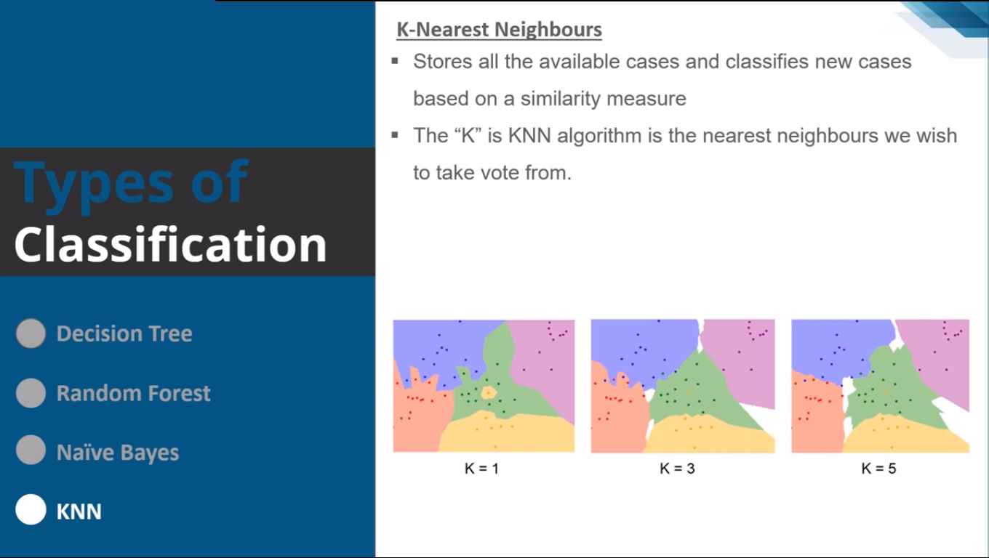

Slide 31
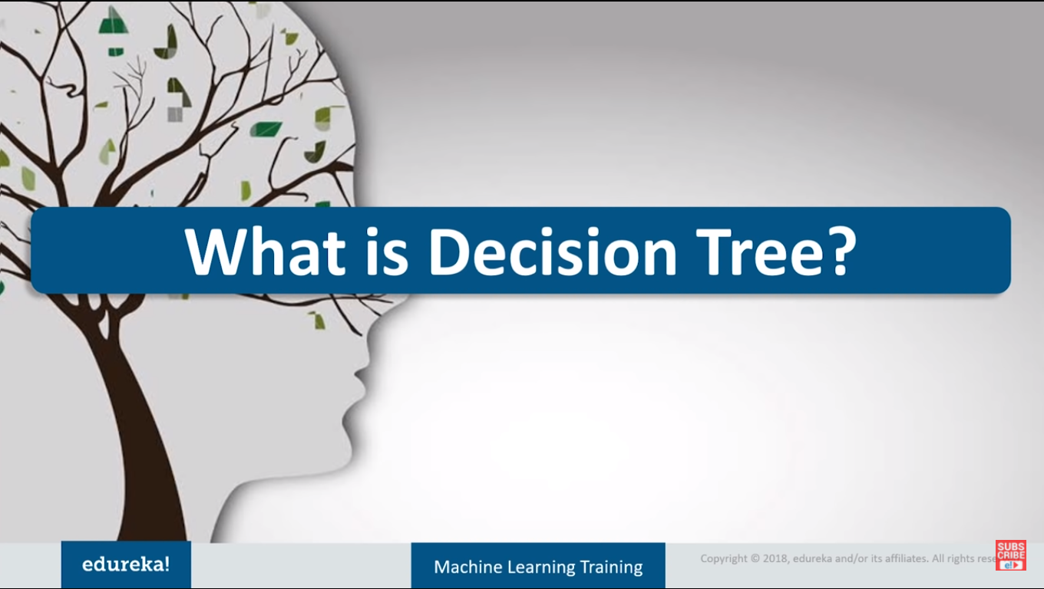

Slide 32
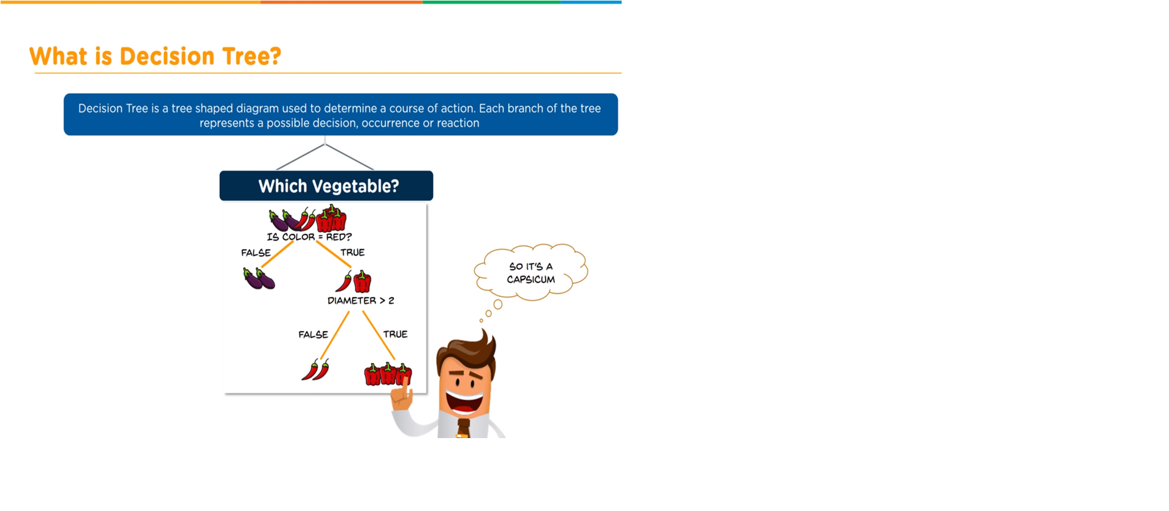

Slide 33
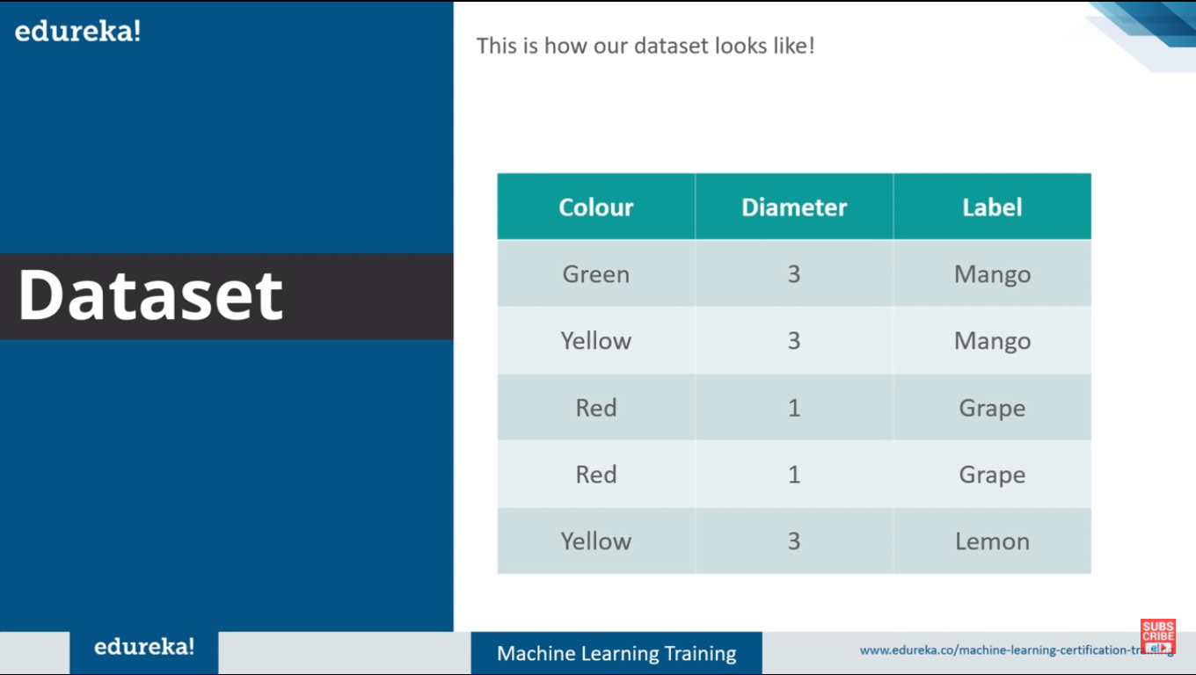

Slide 34
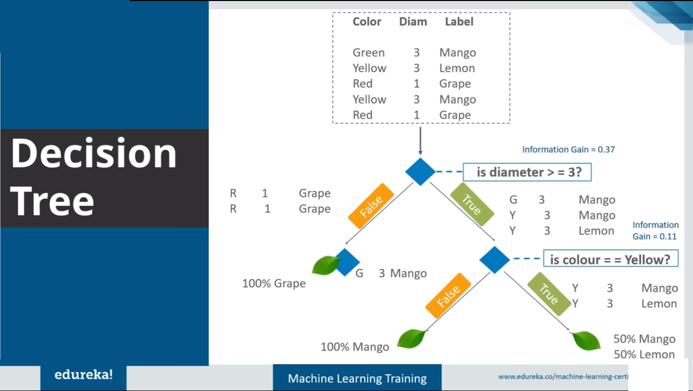

Slide 35
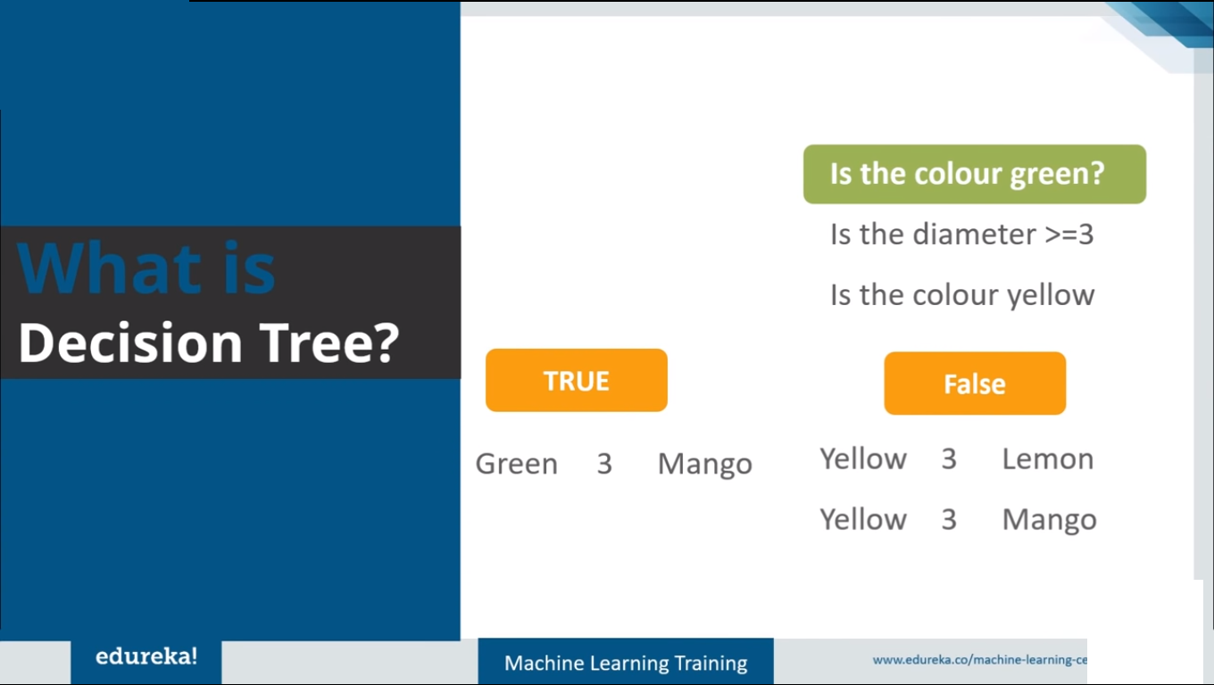

Slide 36
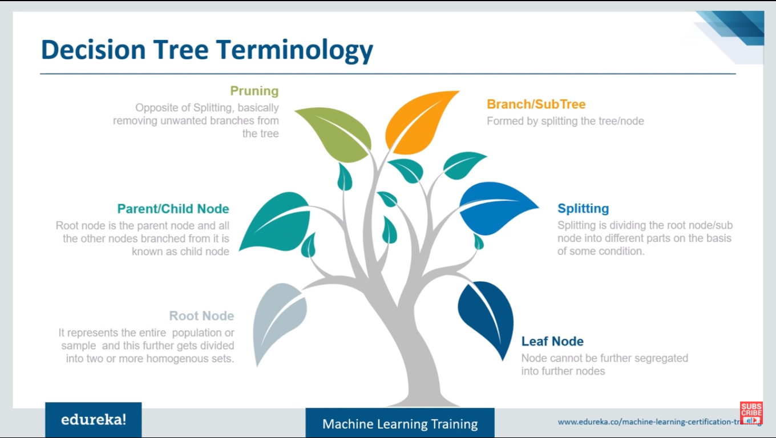

Slide 37
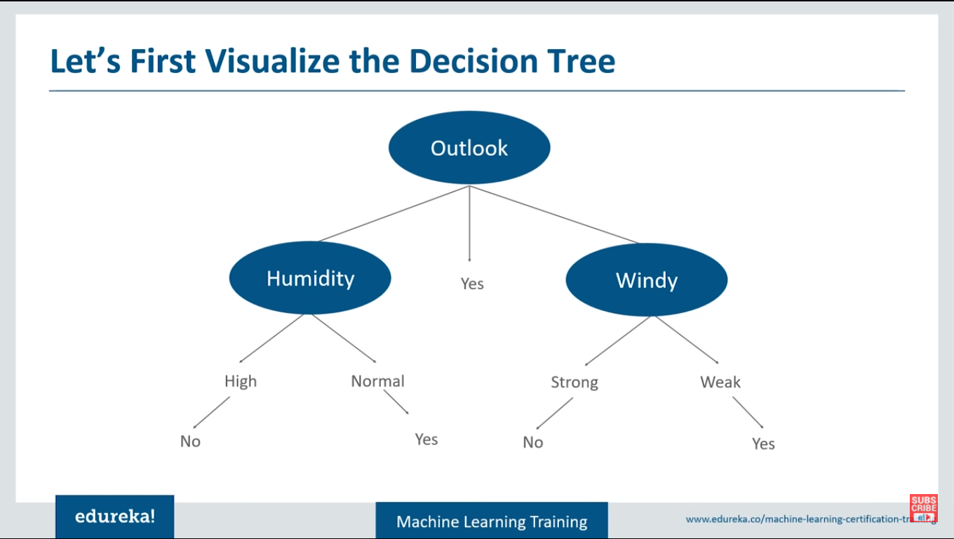

Slide 38
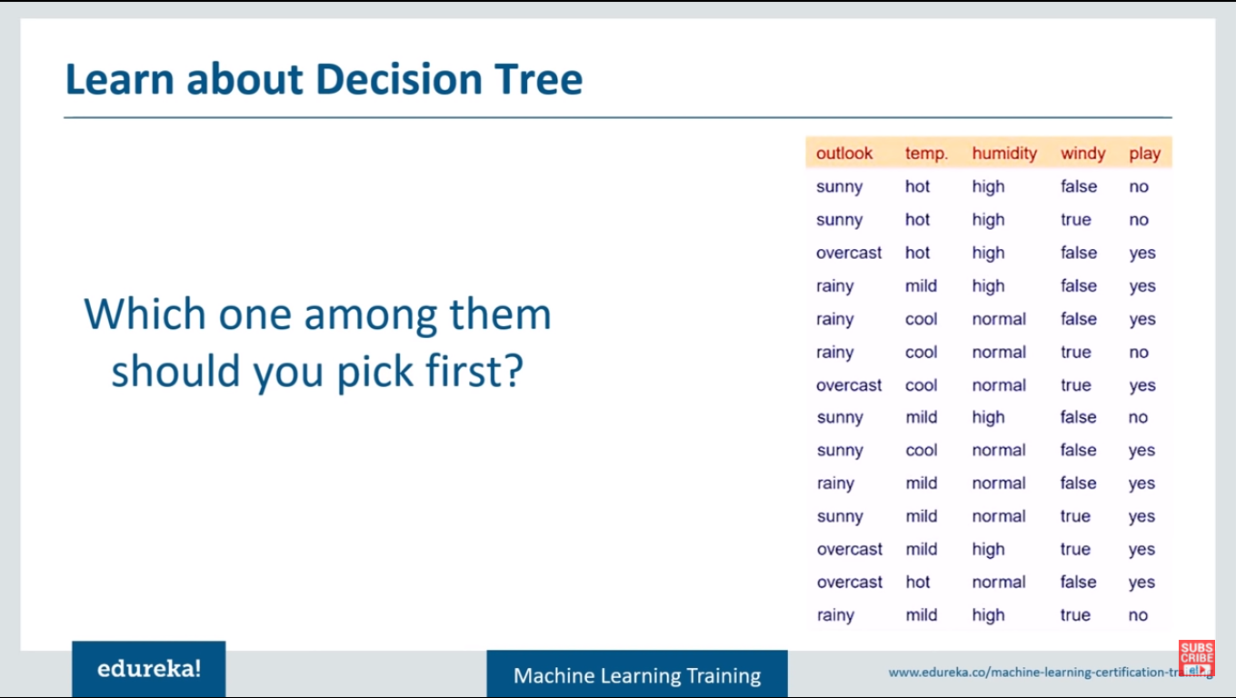

Slide 39
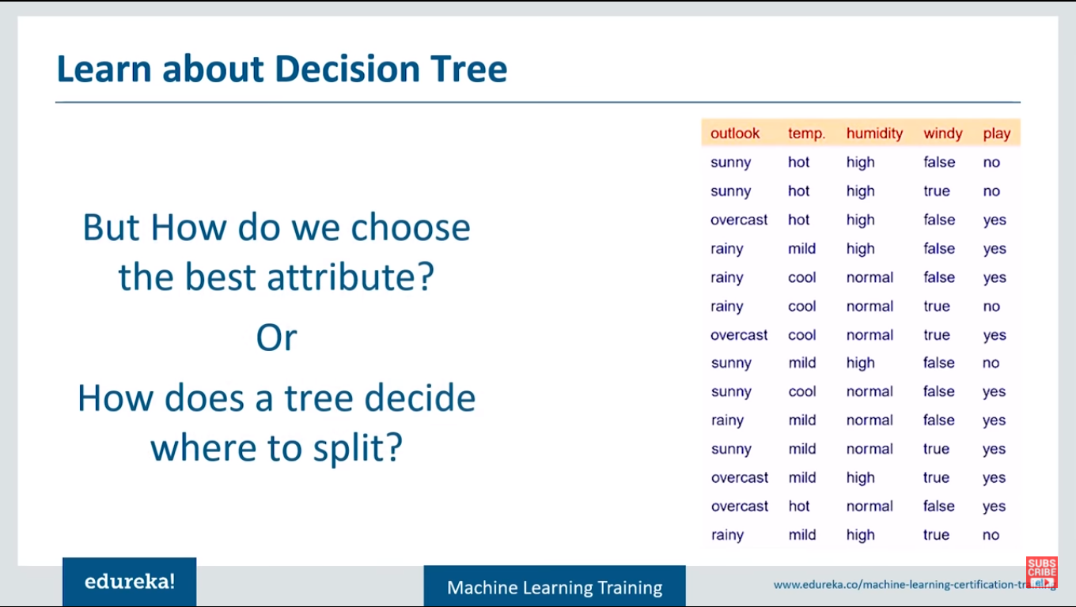

Slide 40
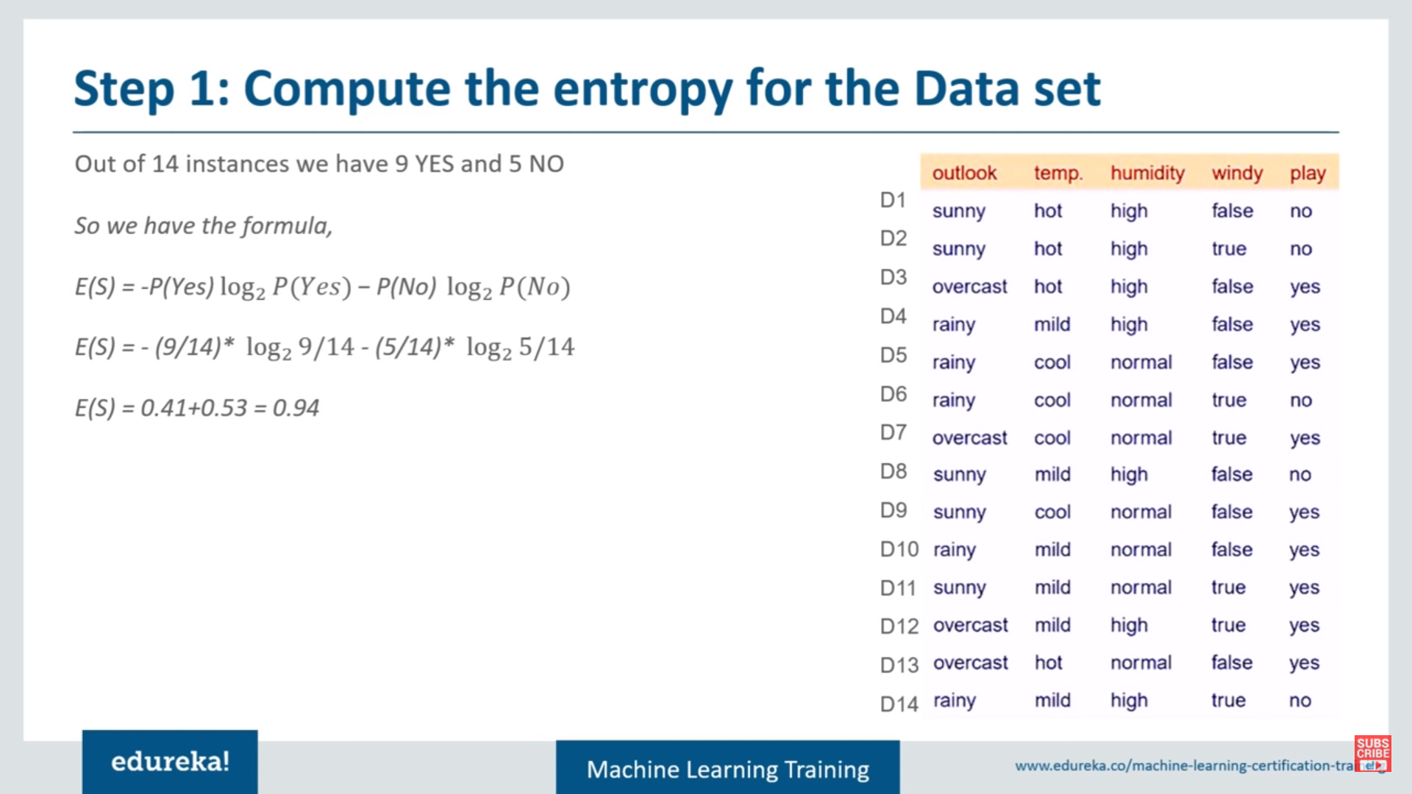

Slide 41
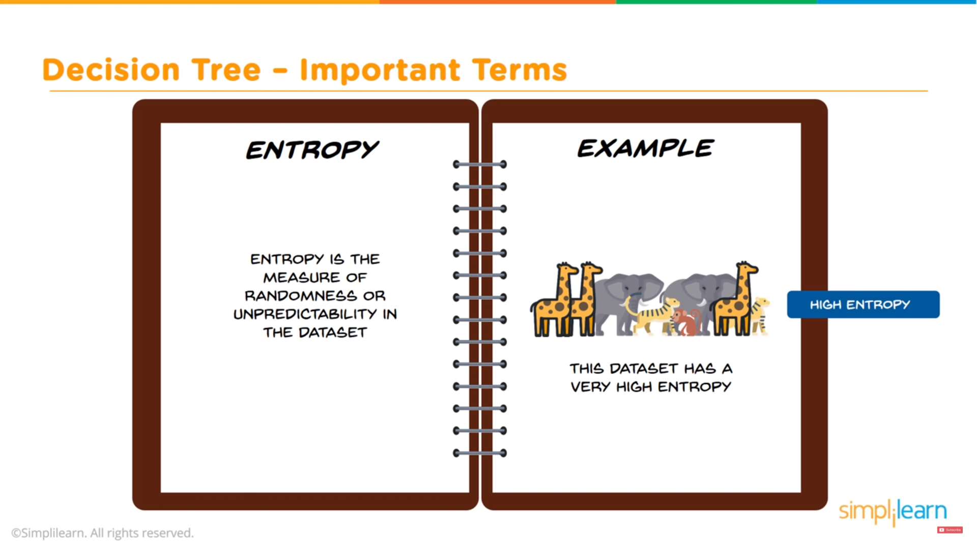

Slide 42
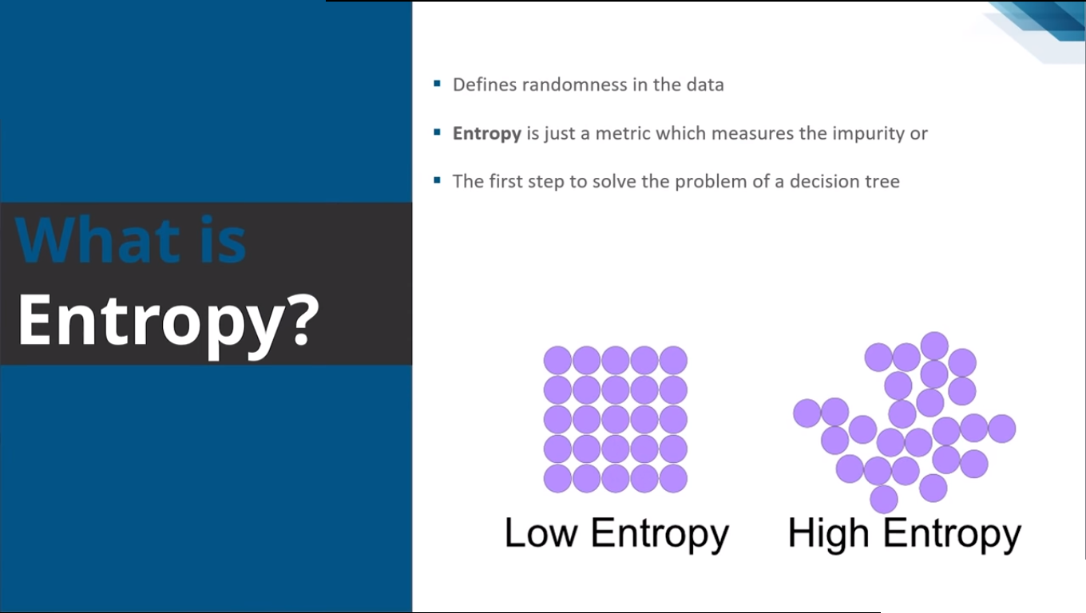

Slide 43
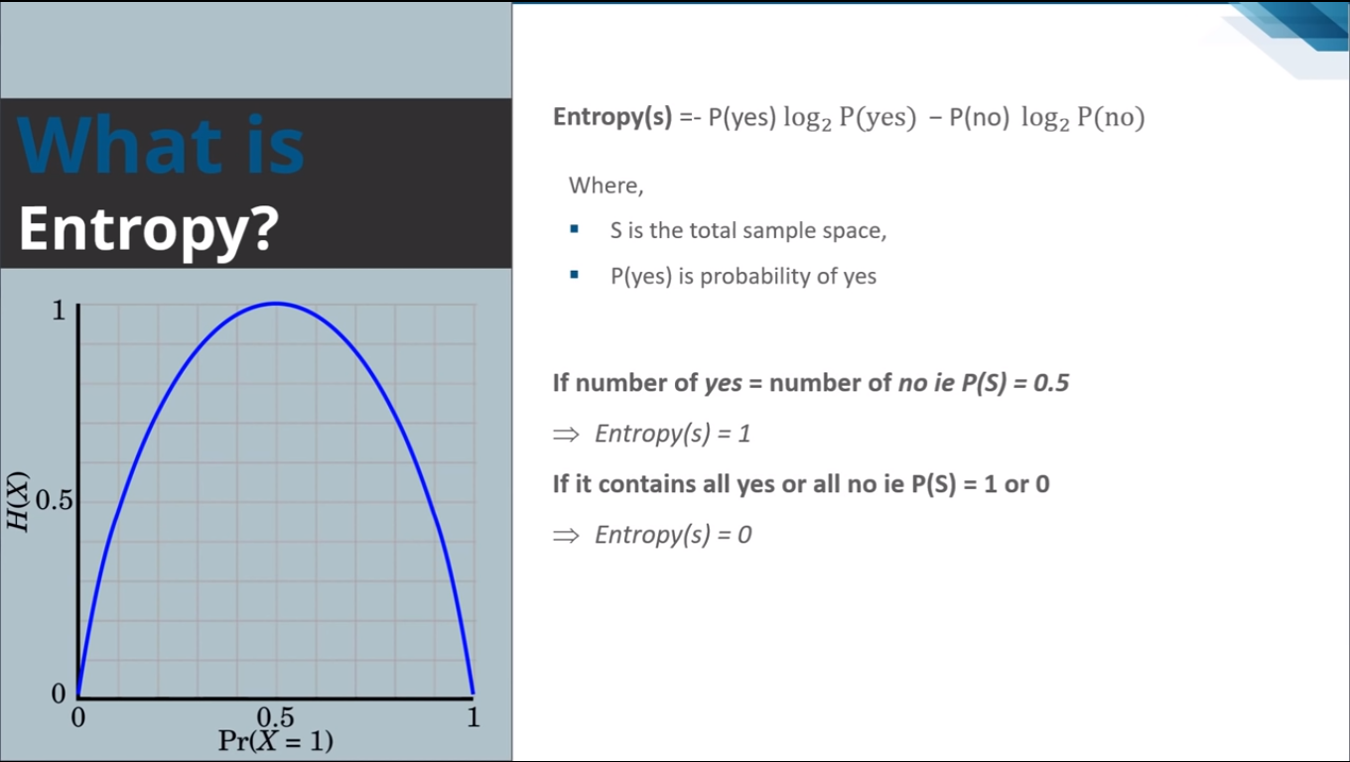

Slide 44
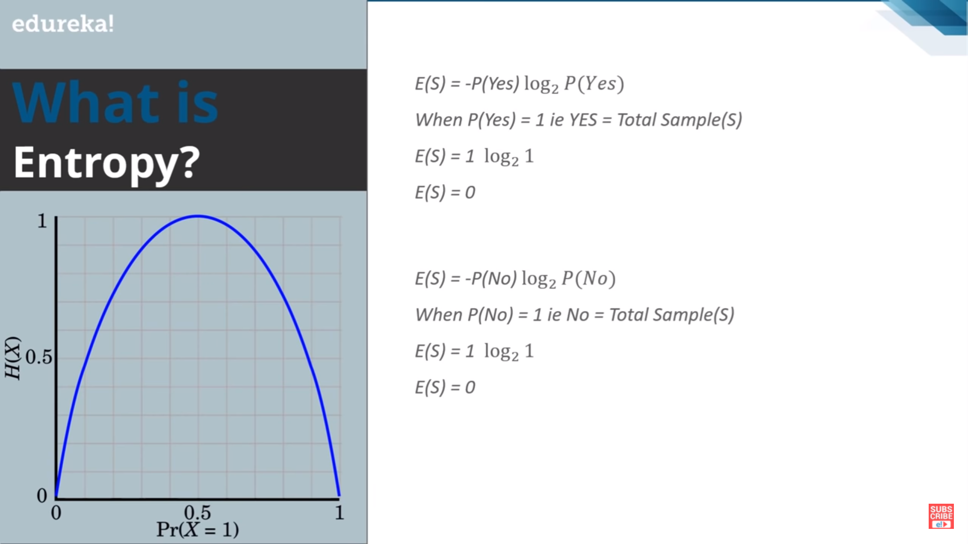

Slide 45
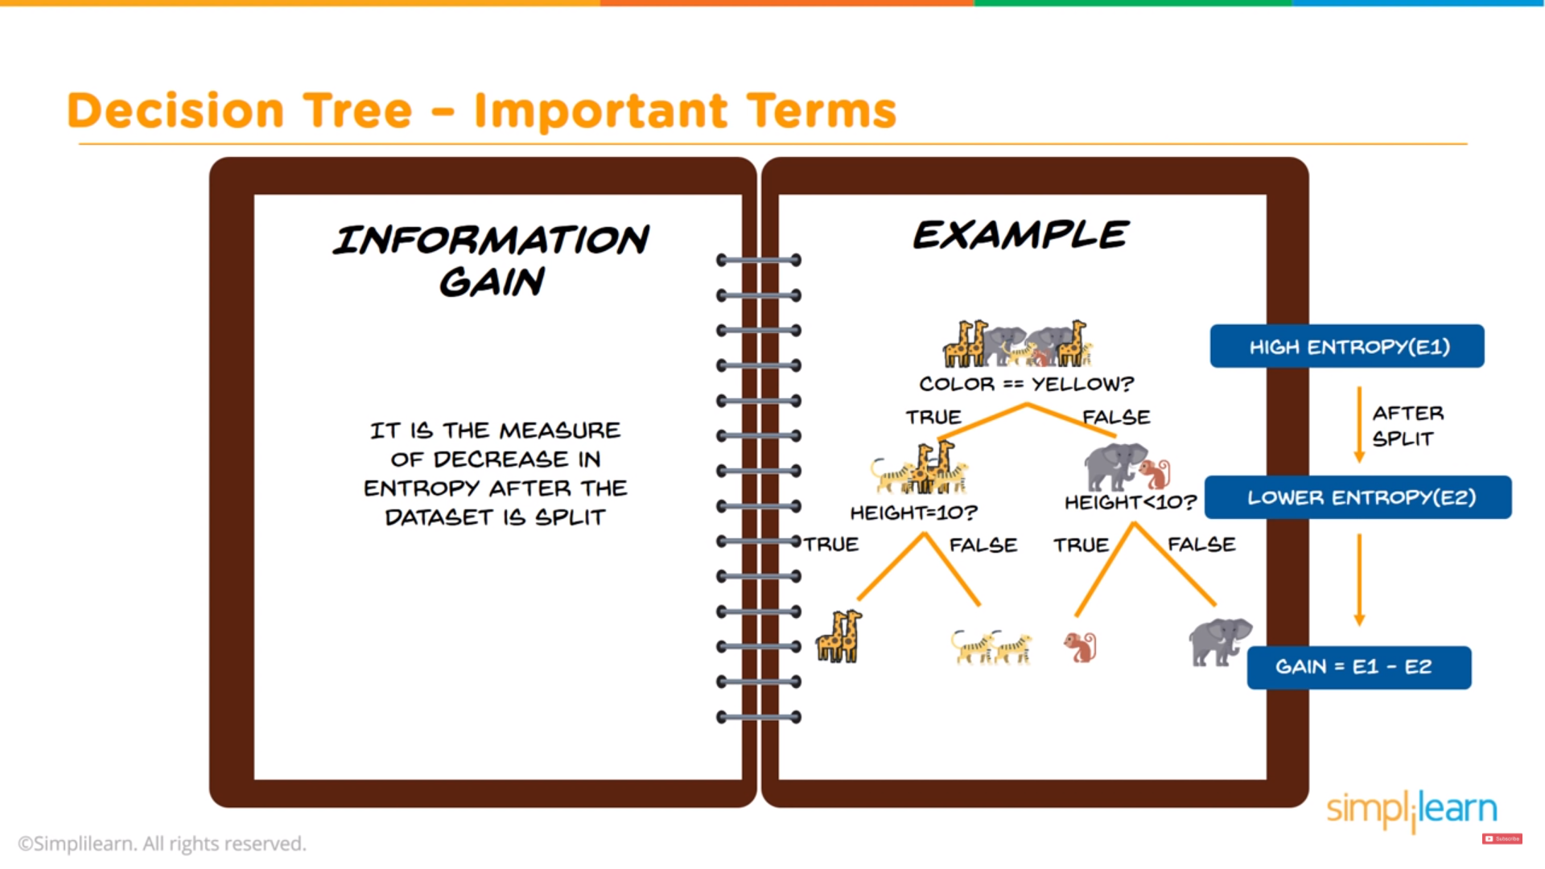

Slide 46
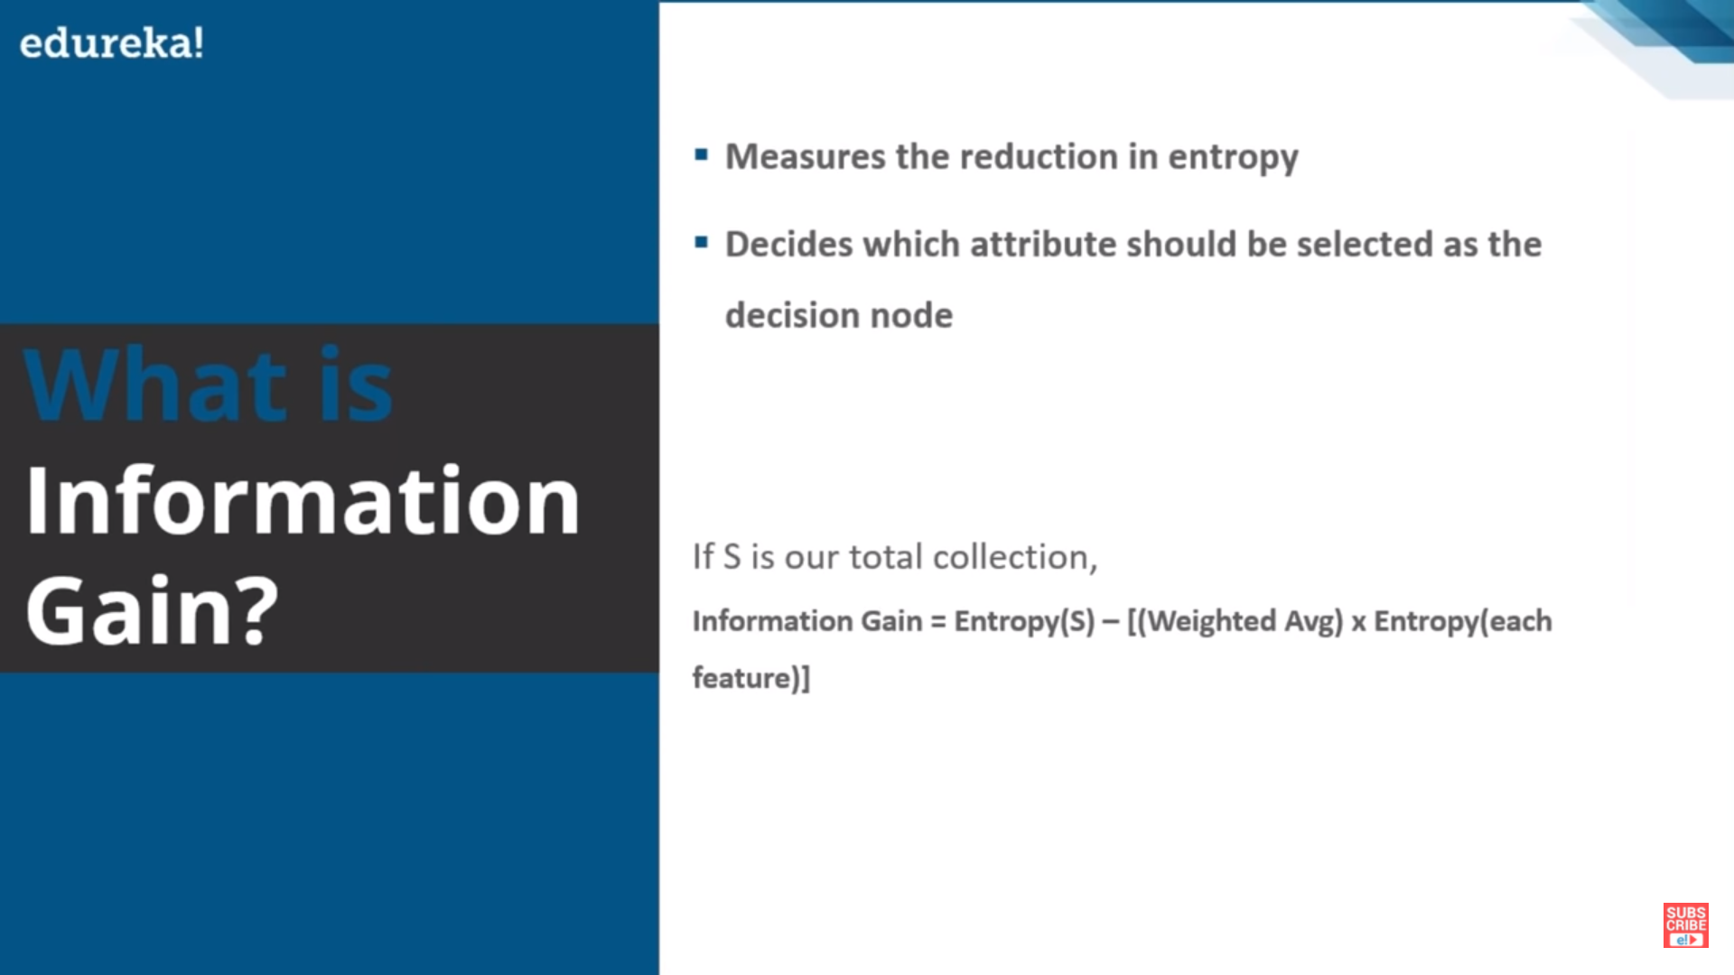

Slide 47
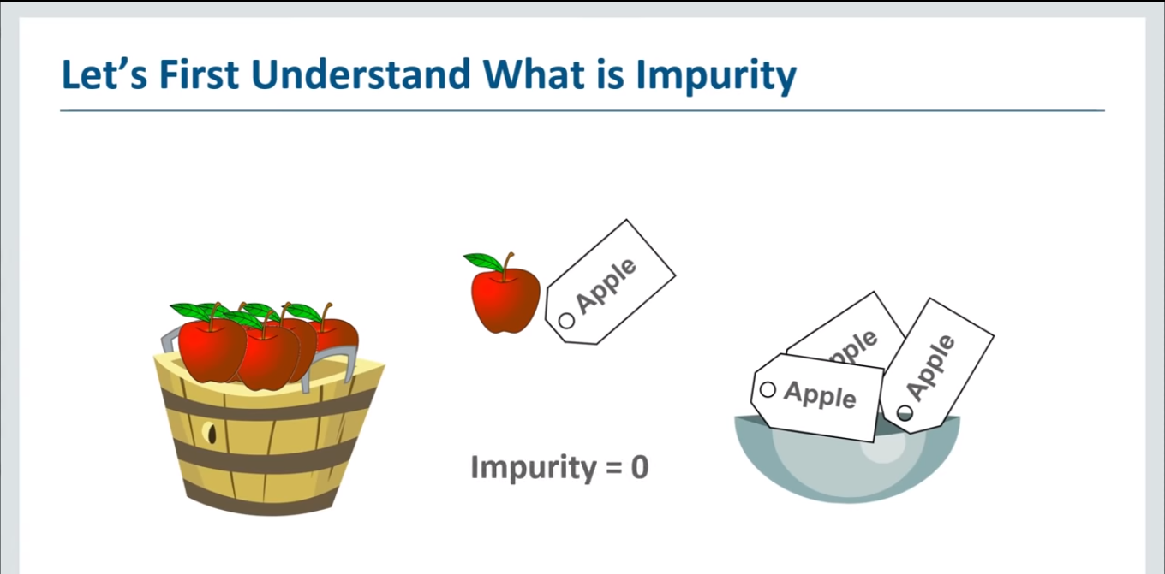

Slide 48
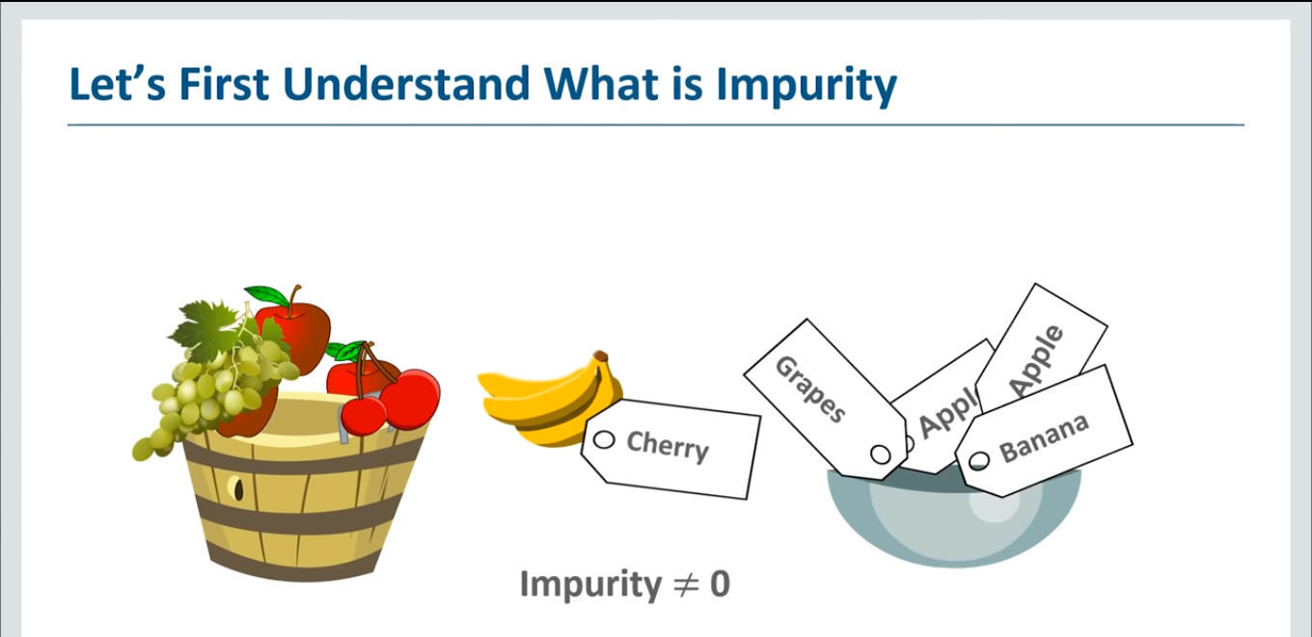

Slide 49


Slide 50
Our Next Assignments
Assignment-8
K- Nearest neighbor (KNN) classifier.
Assignment-9
K-Mean clustering
Assignment-10
K-Medoid clustering.

